Slide 1
Final Project – National Investigation Unit,
Scenario 3
Daryl Bishop, Ryan Donaghue, Danny Martin, Samuel Knapp, Katie Barrett & Lily Finnegan-Hutchinson

Slide 2
Table of Contents
Project Brief
Planning & design
Cloud Infrastructure
CI Server
Testing
Demo
Summary

Slide 3
Project Brief
Scenario 3 – Suspect flees the scene
An officer has spotted a suspect fleeing the scene of an incident in a car. They have reported back with the car’s number plate. The investigation now need to search on car registration to work out:
Who the suspect was?
Where else have they been?
In your team implement the above scenario using all of the technologies
learnt during the training to date, both programming and Devops.

Slide 4
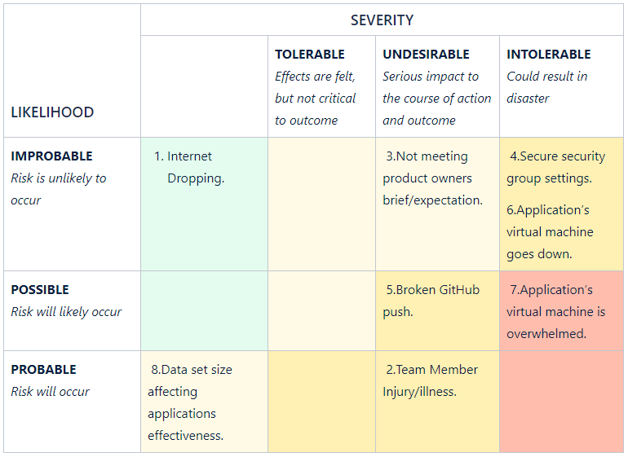
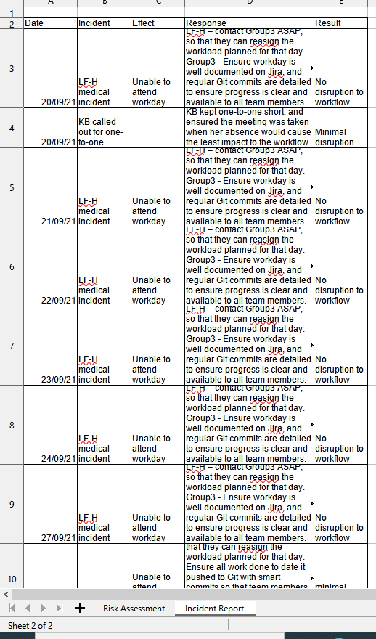
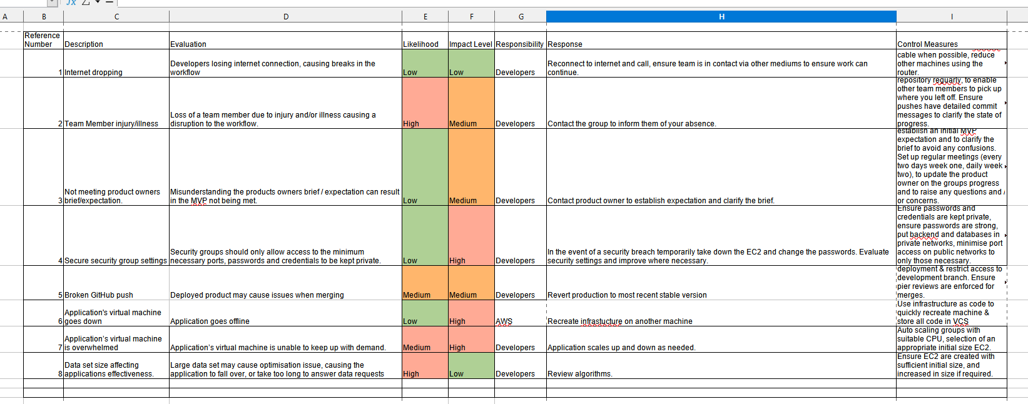
Planning & Design
Risk Assessment

Slide 5
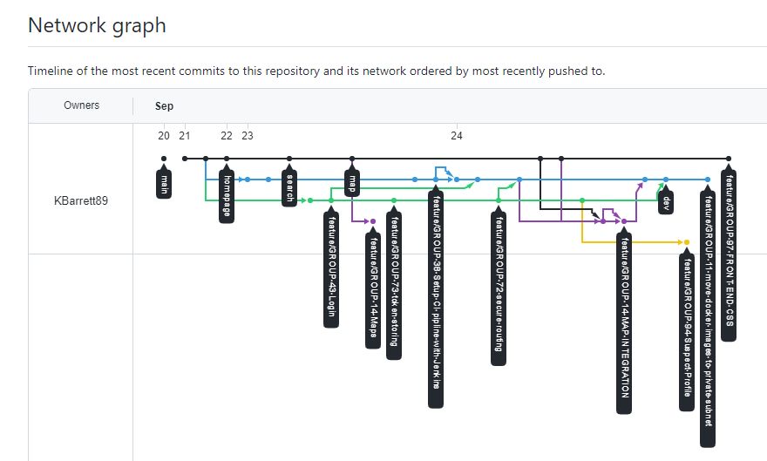
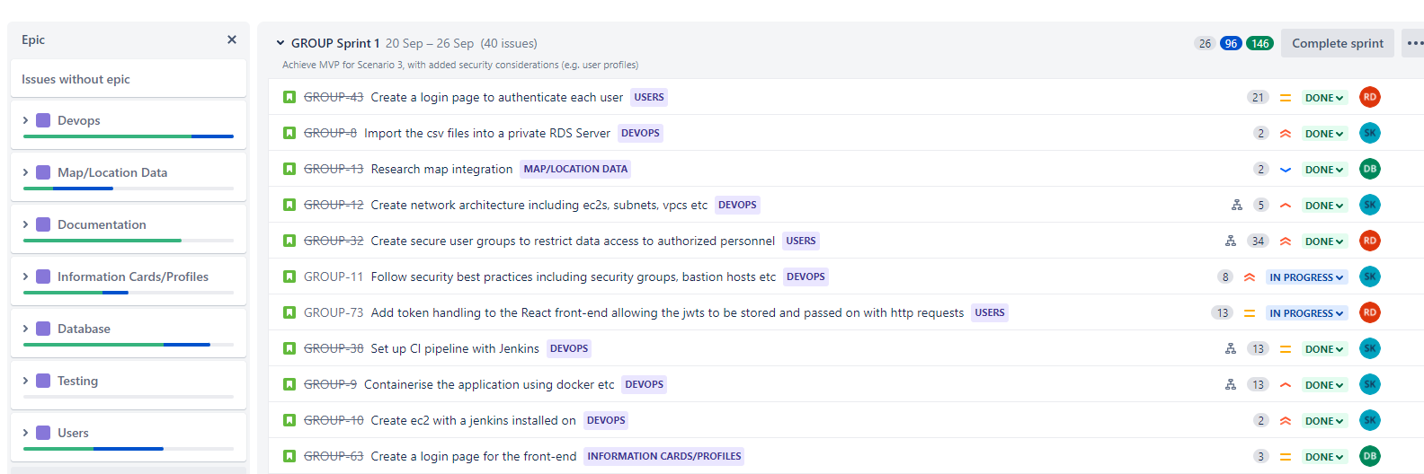
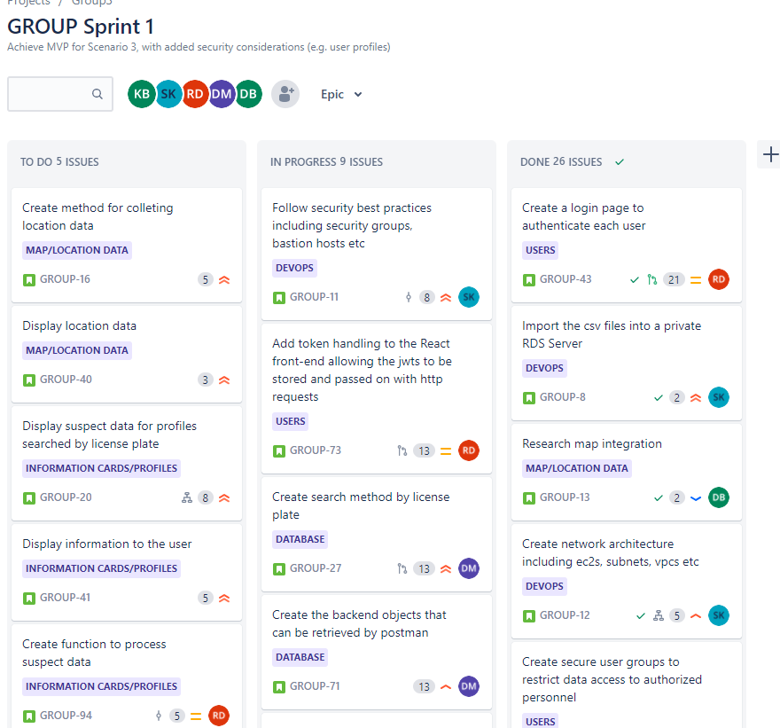
Planning & Design
Jira Scrum board / GitHub

Slide 6
Cloud Infrastructure

Slide 7
CI Server

Slide 8
Testing

Slide 9
DEMO

Slide 10
Summary
Good:
Bad:
Learnt:
Differently:

Slide 11
THANK YOU!

